Slide 1
.
The choice theory: Policy Implications

Slide 2
Bonus packs and price discounts
‘Virtuous good’ or a ‘vice good’
Most goods are virtuous goods, being good for us in the long run, and in this case bonus packs are the more effective method for promoting additional sales. The reason is that price discounts can be harmful to brand image if they are used on a regular basis.

Slide 3
Continued…
For vice goods: the price discounts may be a better method.
The reasoning here relates to post-purchase guilt. Consumers may find it difficult to justify to themselves buying additional amounts of goods that are bad for them in the long run.
Additional behavioral factors such as consumer reactions to product bundling, and whether consumers are naïve or sophisticated are relevant in this context.

Slide 4
Jury awards of punitive damages
The psychology underlying these awards was investigated by Kahneman, Schkade and Sunstein (1998). Three main questions were asked about scenarios relating to compensatory damages in product liability cases:
How outrageous was the defendant’s behavior?
How severely should the defendant be punished?
How much should the defendant be required to pay in punitive damages?
.

Slide 5
Continued…
Findings
The respondents experienced a degree of outrage that was independent of the amount of harm caused.
However, when it comes to judging punitive intent and assessing damages, the second and third questions, the consequences of the behavior are of great importance.
The defendant’s ability to pay was relevant as far as the third question is concerned.
Their conclusion was that jurors are good at combining
normative evaluations with empirical facts. However, their ability to translate these intuitions into dollars appears to be weak.

Slide 6
The Contingent Valuation Method (CVM) and public goods
CVM is often used as a means of eliciting the value the people place on public goods, including non-use goods such as the continued existence of rare species.
The valuation produced is then used as a basis for public policy decisions.
CVM sometimes relies on asking people to report their stated willingness to pay (SWTP).

Slide 7
Continued…
1. Anchoring effects- these are prominent in a number of situations, for example the estimation of punitive damages.
2. Insensitivity to scope- This is a form of extension bias. Kahneman (1986) found that Toronto residents were willing to pay only a little more to clean up all the polluted lakes in Ontario than to clean up polluted lakes in a particular region of Ontario.
Jones-Lee, Loomes and Philips (1995) found that the SWTP of UK respondents to a program to reduce the risk of non-fatal road injuries increased by only 29% when the number of prevented injuries was increased by 200%.

Slide 8
Continued…
Some improvements to the SWTP technique of CVM have been proposed, notably the referendum protocol. This involves asking people simply to vote on an issue; the wording of the question for a particular respondent would, therefore, only quote a single value, for example: ‘Would you vote for a proposition requiring you to pay $20 to clean up Lake Ontario?’.

Slide 9
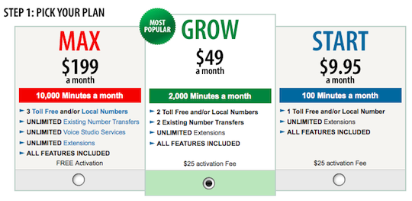

Slide 10
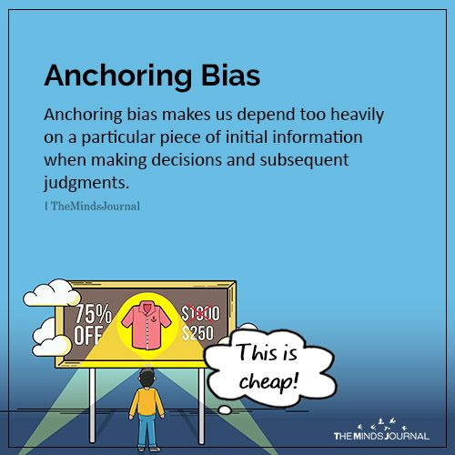

Slide 11
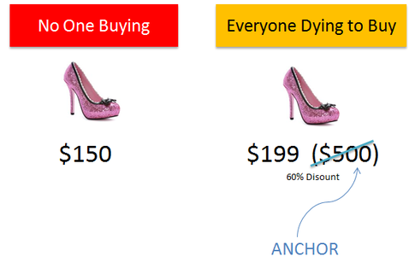

Slide 12
Crime and punishment
There are various purposes of punishment, including retribution, the achievement of justice, removal of danger, deterrence.
Smacking of children in the UK: Historically, polls asking parents if they want to ban smacking have come up with a majority response of ‘no’. But more recent work by the Children Are Unbeatable Alliance, a coalition of charities opposed to smacking, asking if children should have the same legal protection as adults from assault, has elicited a resounding ‘yes’ from parents.
Flaws in the case:
Framing effect, different kind of treatments, effectiveness of deterrent

